Slide 1
Salary in data Jobs
Datex
Racheal and Johannes

Slide 2
Project Overview
A website that evaluates the salary offered by the company based on various factors such as job category, geographic location and experience level of the individual.
Essentially, it would serve as a tool for these professionals to determine if their potential earnings are in line with industry standards for similar roles and experience levels.
There is a big difference between salary and the country you work in, regardless of the employee's experience.
There should be no significant difference between the salary and the work setting in which you work e.g. remote, hybrid, in person

Slide 3



Data Acquisition, Enrichment, and Examination
Challenges data sourcing and integration:
Find data that we can integrate into our database where it makes sense
The structure of both databases to be able to merge them
The supplementary data matches your main dataset in the country column and provides supplementary data for the different countries in our primary dataset.

Slide 4
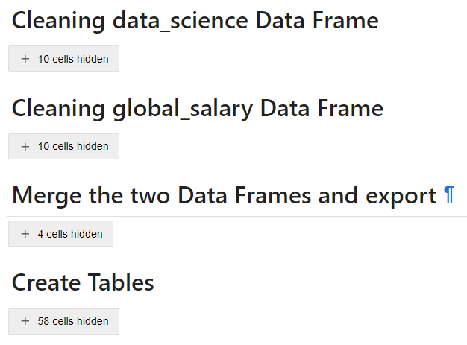
Data Transformation
Major Obstacle
-> We couldn’t populate the tables in mySQL
->Without Created Tables it was not possible
to start with the SQL

Slide 5
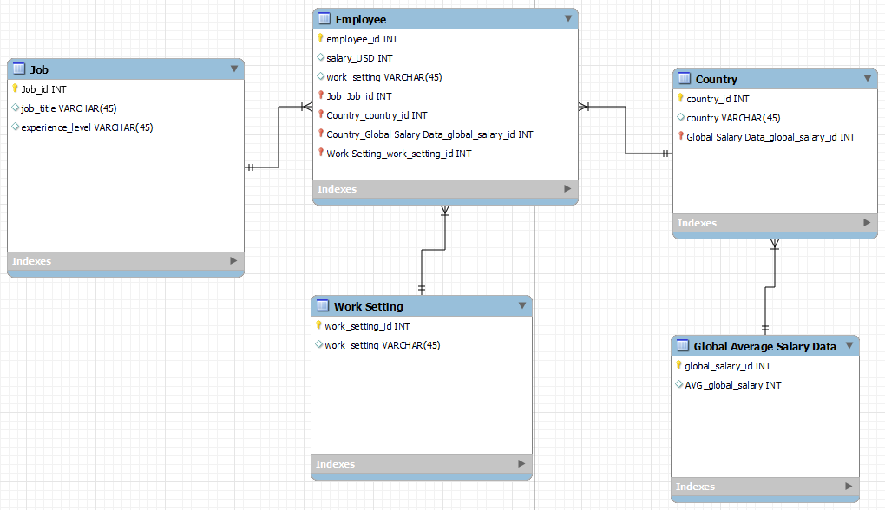
Database Design
Challenges: The best way to divide the database into tables and what such a structure looks like
-> Split the columns of repeated data and tried to categorise them

Slide 6
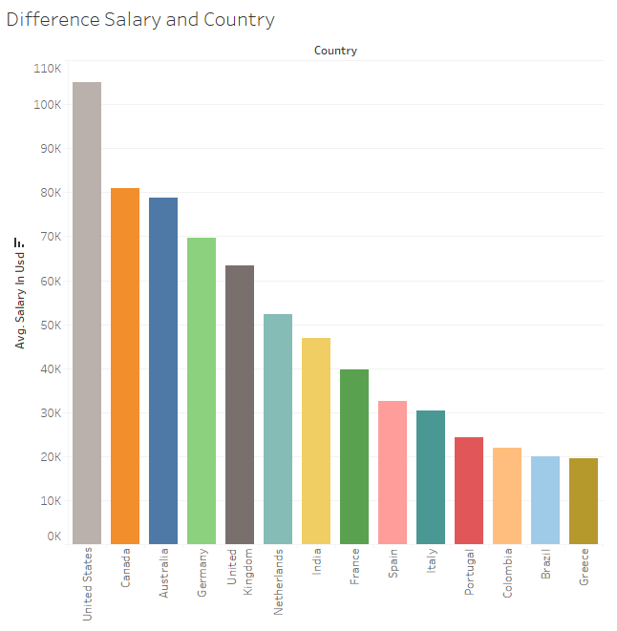
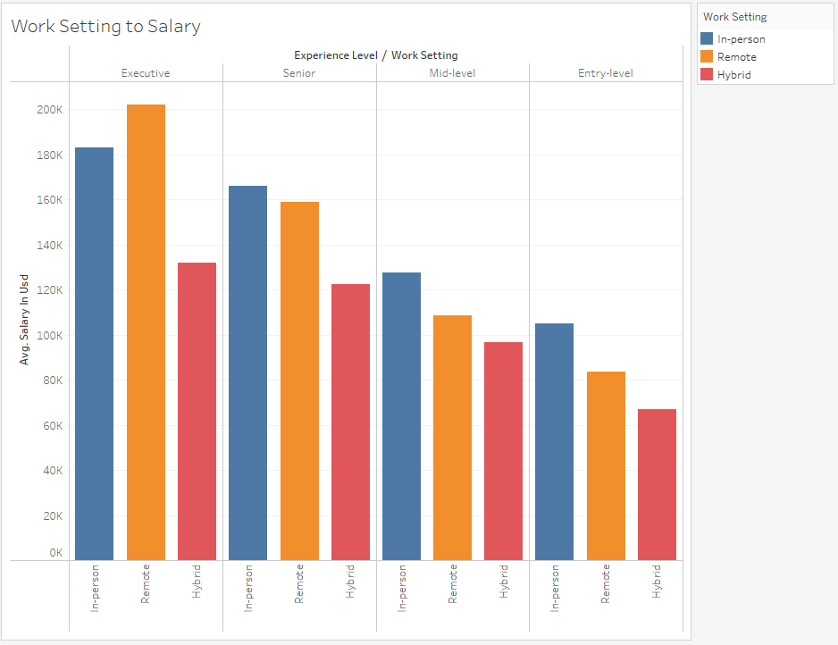
Visualization & Key Insights 1

Slide 7
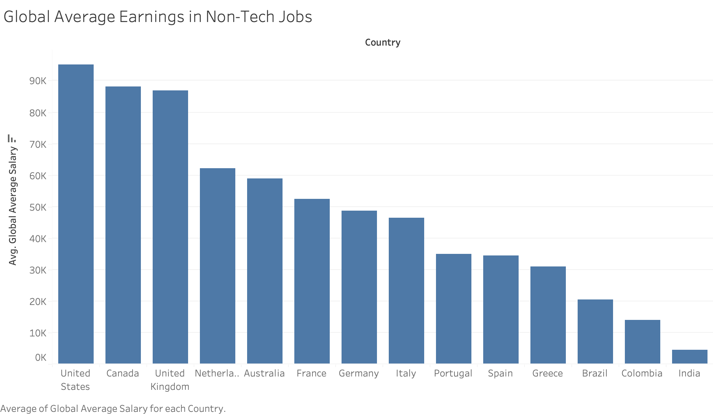
Visualization & Key Insights 2

Slide 8
Conclusions & Business Implications
There is a big difference between salary and the country you work in, regardless of the employee's experience.
-> The data shows that there are large differences between countries and salaries, regardless of professional experience and even regardless of the job category
There should be no significant difference between the salary and the field of work in which you work e.g. remote, hybrid, in person
-> The data shows that there is no direct pattern in terms of working setting, but it is noticeable that in almost all cases the hybrid is the one with the lowest salary.
Potential business implications could be getting more data from different countries to expand and finding out cost of living to see if working in another country could be interesting

